Slide 1
Samples, Populations
11.2

Slide 2
What You Will Learn
Distinguish between populations and samples.
Analyze hypotheses

Slide 3
A population is the collection of all data, such as response, measurements, or counts, that you want information about.
A sample is a subset of a population
A census consists of data from an entire population. But, unless a population is small, it is usually impractical to obtain all the population data. In most studies, information must be obtained from a random sample ( you will learn more about this later).
It is important for a sample to be representative of a population so that the sample data can be used to draw conclusions about the population. When the sample is not representative of the population, the conclusions may not be valid. Drawing conclusions about populations is an important use of statistics. Statistics is the science of collecting, organizing, and interpreting data.

Slide 6
Vocabulary
Parameter: A numerical description of a population
Statistic: A numerical description of a sample
Because some populations are too large to measure, a statistic, such as the sample mean, is used to estimate the parameter, such as the population mean. It is important that you can distinguish between a parameter and a statistic

Slide 9
Population: All retail gasoline outlets in the United States
Sample: the 800 retail gasoline outlets the EIA called.
Population: All shoppers in the United States
Sample: The 4464 shoppers in the United States surveyed.

Slide 10
Analyzing Hypotheses
In statistics, a hypothesis is a claim about a characteristic of a population.
A drug company claims that patients using its weight-loss drug lose an average of 24 pounds in the first three months.
A medical researcher claims that the proportion of U.S. adults living with one or more chronic conditions, such as high blood pressure, is 0.45 or 45%
To analyze a hypothesis, you need to distinguish between results that can easily occur by chance and results that are highly unlikely to occur by chance. One way to analyze a hypothesis is to perform a simulation. When the results are highly unlikely to occur, the hypothesis is probably false.

Slide 11
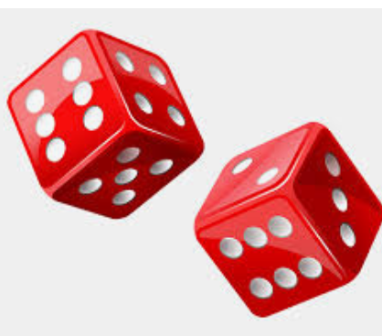
Analyzing a Hypothesis

Slide 12
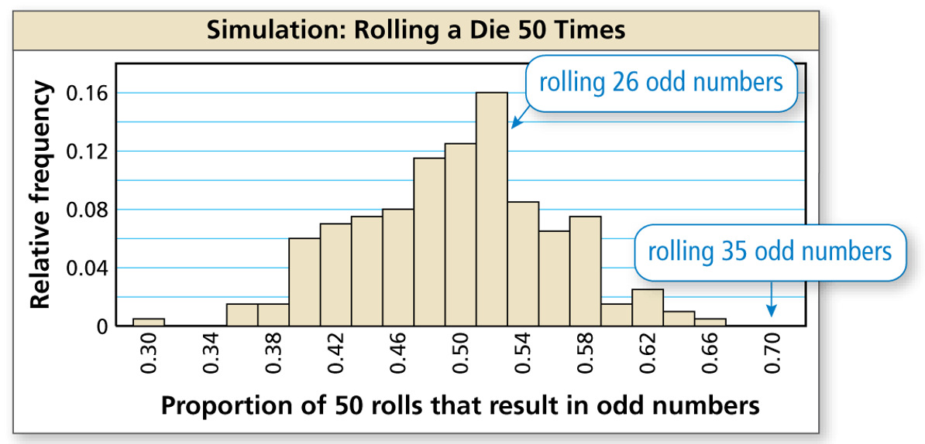

Slide 14
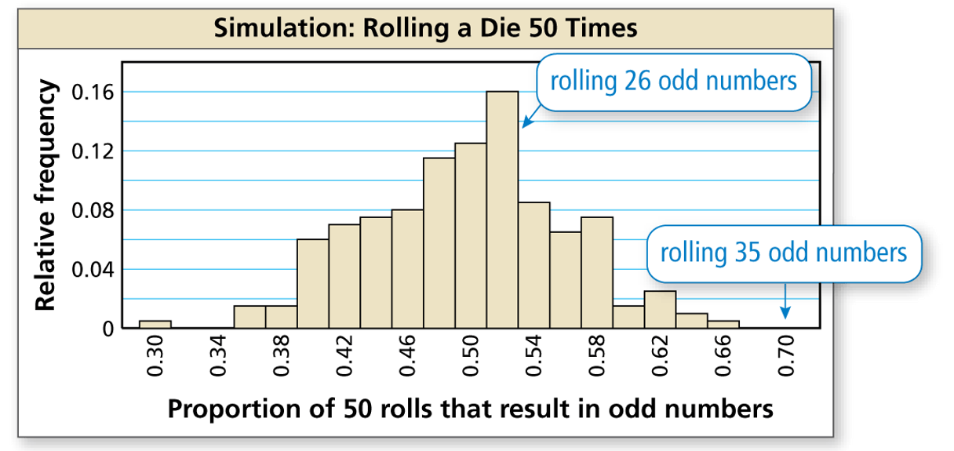
15 17 19 21 23 25 27 29 31 33 35
Number of 50 rolls that result in odd numbers
In this simulation, getting 35 odd numbers in 50 rolls apparently did not happen, or happened so few times it does not show up on the plot. Because getting 35 odd numbers is highly unlikely to occur by chance, this simulation confirms that you can conclude the maker’s claim is most likely false.

Slide 15
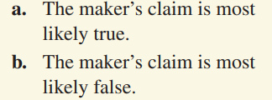
What would you conclude when you roll the actual die 50 times and get (a) 24 odd numbers and (b) 31 odd numbers?

Slide 16
Conclusions:
Yes, I *AM* Captain Obvious!

Slide 17
Homework: Textbook page 607: 5 – 15 odd, 19, 21, 25

